Slide 1
🏛️ What is Database Architecture?
Database architecture is the way a database system is designed and structured — like the blueprint of a house.
Imagine a library:
Bookshelves = Storage (where data lives).
Librarian = Database Engine (manages and fetches books).
Catalog = Schema/Index (tells you where to find things).
Readers = Users/Applications.
That whole setup (how books are stored, searched, and managed) = Database Architecture.
Notes:
Task 1:identify various Query Engines?
Task 2: What are various Query Executors ?
Task 3: ACID explain & give example for each?

Slide 2
⚙️ Types of Database Architectures
1-Tier (Standalone)
Everything on one machine (like MS Access on your laptop).
Example: A student’s project DB.
2-Tier (Client-Server)
Application (client) talks directly to database (server).
Example: Bank employee using a software that directly queries the database.
3-Tier (Most Common)
Client (user) → Application server (logic) → Database server.
Example: Online shopping (user app → business logic → product database).

Slide 3
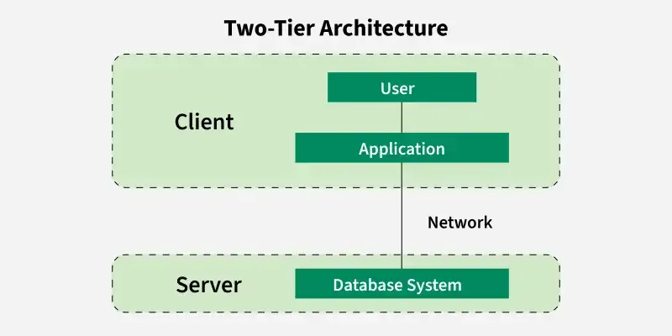
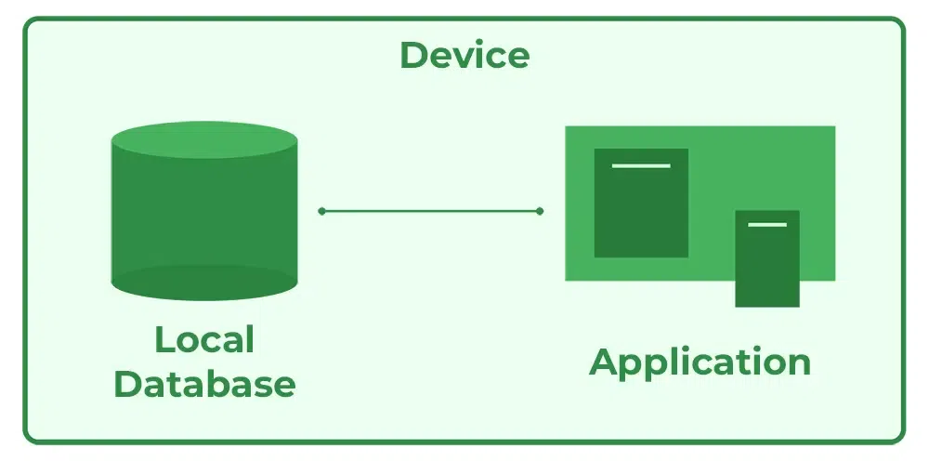
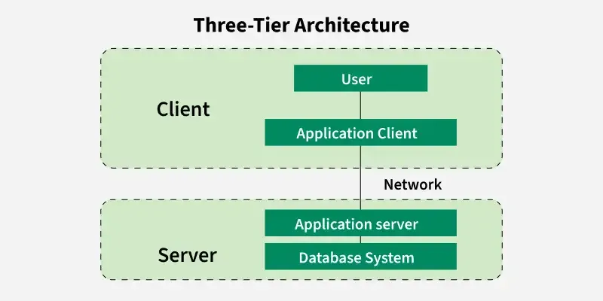
DBMS architectures
👉 Layman analogy:
1-Tier = Cooking and eating alone in your kitchen.
2-Tier = Ordering directly from the chef.
3-Tier = Ordering from a waiter, who talks to the chef, who fetches food from storage

Slide 4
🔑 Key Factors When Choosing a Database
When deciding which database to use, we consider:
Type of Data
Structured (tables: MySQL, PostgreSQL).
Unstructured (text, video, images: MongoDB, Cassandra).
Scalability
Can it handle growth?
Example: Banking requires scalable RDBMS; social media may use NoSQL.
Performance (Speed)
Read-heavy vs Write-heavy workload.
Example: Analytics (fast reads), Logging (fast writes).
Reliability & Consistency
ACID compliance (transactions should be safe).
Example: Money transfers must not fail.
5.Security
Support for encryption, user access control
6. Cost
Open-source (MySQL, PostgreSQL) vs Licensed (Oracle, SQL Server).
7. Community & Support
Is it widely used? Easy to hire talent? Documentation?
8. Integration
Can it easily connect with your apps, cloud, or analytics tools?

Slide 5
⚙️ Key Components of Database Architecture
👉 Think of a database like a restaurant 🍴:
The kitchen = Storage (where raw data is kept).
The chefs = Database Engine (prepares data).
The menu & waiter = Query Processor (takes your order, gets the right data).
The manager = Transaction Manager (ensures accuracy & rules).
The security guard = Security Manager (controls who enters).

Slide 6
4. Transaction Manager
Ensures ACID properties (Atomicity, Consistency, Isolation, Durability).
Manages multiple users accessing the database at the same time.
Like the restaurant manager ensuring every order is handled properly (no missing food, no double charges).
5. Metadata / Catalog (Schema)
Stores information about the data (table structure, columns, indexes, relationships).
Like the recipe book for chefs.
6. Security Manager
Controls authentication (who can log in) and authorization (what they can do).
Like the security guard at the restaurant door.
7. Backup & Recovery System
Ensures data is safe if the system crashes.
Like having a fire exit plan & insurance for the restaurant.
🧩 Main Components
1. Database Storage (Data Files)
Where actual data lives (tables, indexes, logs).
Like a pantry in the kitchen.
2. Database Engine
The heart of the system.
Responsible for reading/writing data, enforcing rules.
Like the chefs who cook and serve data.
3. Query Processor
Translates user’s request (SQL query) into a plan the database understands.
Includes:
Parser (checks SQL syntax).
Optimizer (finds the fastest way to run query).
Executor (runs the query).
Like the waiter & menu that helps get food correctly and quickly.

Slide 7
Storage → Data’s home
Engine → Brain of the database
Query Processor → Translator of SQL
Transaction Manager → Ensures safe, correct operations
Metadata → Data about data
Security → Protects access
Backup & Recovery → Safety net

Slide 8
When to Use Which?
Architecture | When to Use | Example
1-Tier | Small, single-user apps, testing | MS Access, SQLite
2-Tier | Client-server apps, moderate users | Local bank branch systems
3-Tier | Large, secure, scalable apps | Amazon, Flipkart
Distributed/N-Tier | Global-scale, high availability | Google Spanner, Facebook DB, Cassandra

